Slide 1
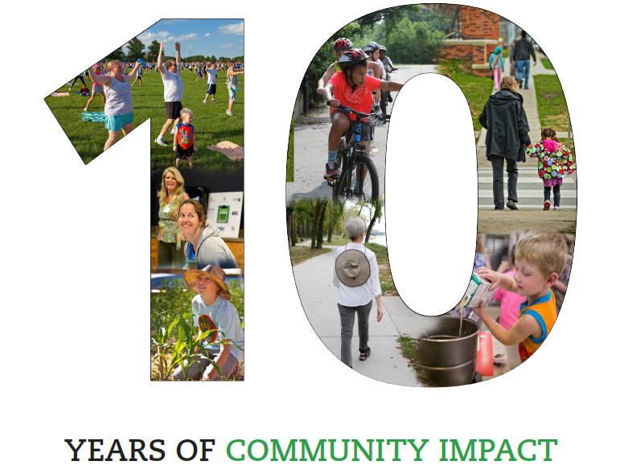

Slide 2
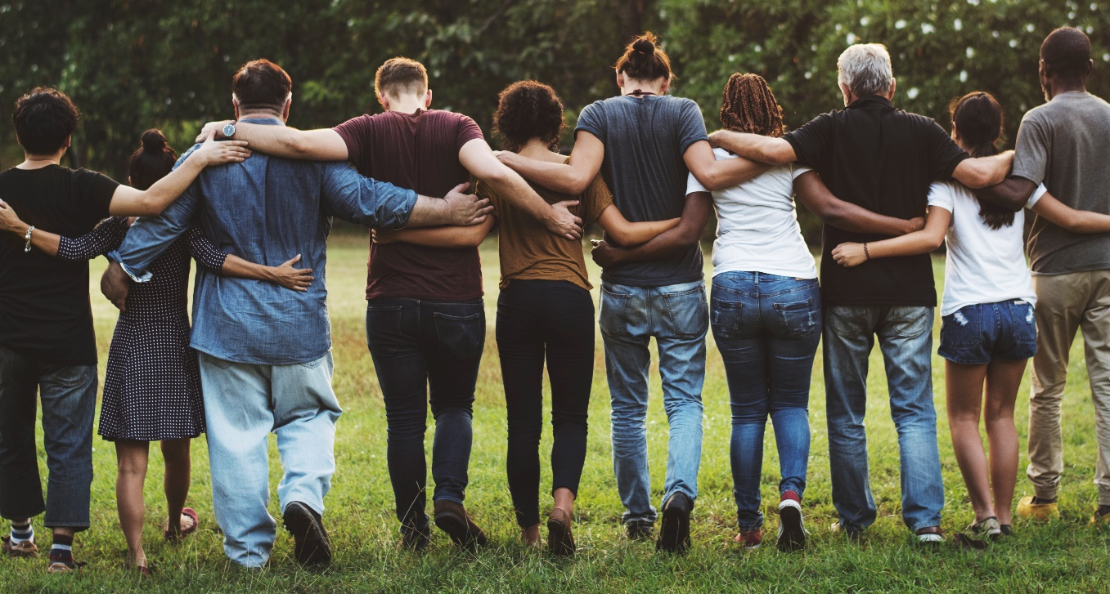
LiveWell Vision and Mission
Our Vision: Communities where we all thrive.
Our Mission: Leading a movement to build communities that support the health and well-being of all.

Slide 3
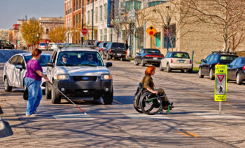
LiveWell focus
Influencing system, policy, and environmental change in our communities.

Slide 4
Partners helping shape our future
At-large community members Ballard Community Services Department of Children and Families Douglas County Food Policy Council Elected officials Friends of Lawrence Area Trails Harvesters Just Food K-State Research and Extension, K-State Research and Extension SNAP KU Center for Community Health and Development KU Health, Sport, and Exercise Sciences KU Medical Center Dietetic Internship Program Lawrence-Douglas County Sustainability Lawrence-Douglas County Health Department, Lawrence-Douglas County Health Department WIC Lawrence-Douglas County Housing Authority Full Circle Youth Program LMH Health Lawrence Pedestrian Coalition | Lawrence Police Department Lecompton United Methodist Church God’s Food Pantry Let’s Talk LiveWell Douglas County Salvation Army Satori Counseling Services Self-Advocate Coalition of Kansas Senior Resource Center for Douglas County Success by 6 Coalition of Douglas County Sustainability Action Network United Way of Douglas County University of Kansas Center for Community Health and Development University of Kansas Research and Training Center on Independent Living University of Kansas Sexual Assault Prevention and Education Center University of Kansas Watkins Health Services USD 497 Lawrence Public Schools Willow Domestic Violence Center

Slide 5
Community health improvement plan
Poverty and jobs
Behavioral health
Safe and affordable housing
Access to healthy food and physical activity
Equity & Discrimination

Slide 6
Objectives (2018-2023)
Increasing food insecurity and healthy eating
Emergency food assistance
Enhance local culture & appreciation of healthy food
Increasing rates of physical activity
Enhancing the built environment
Culture and norms around physical activity

Slide 7
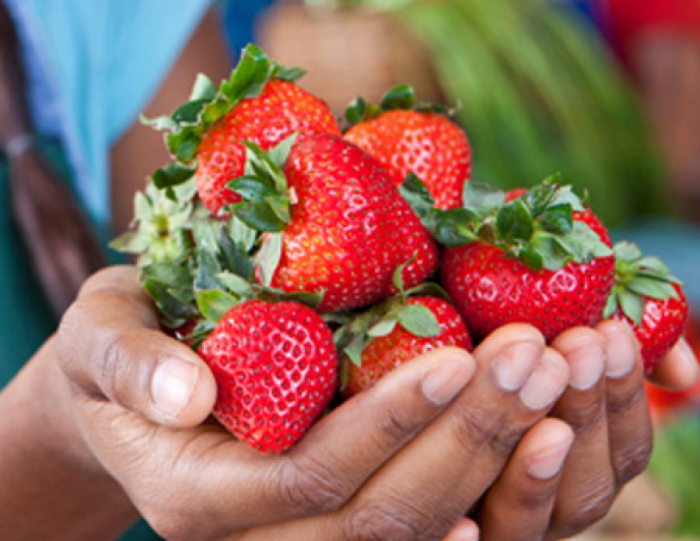
Improving food security/culture

Slide 8
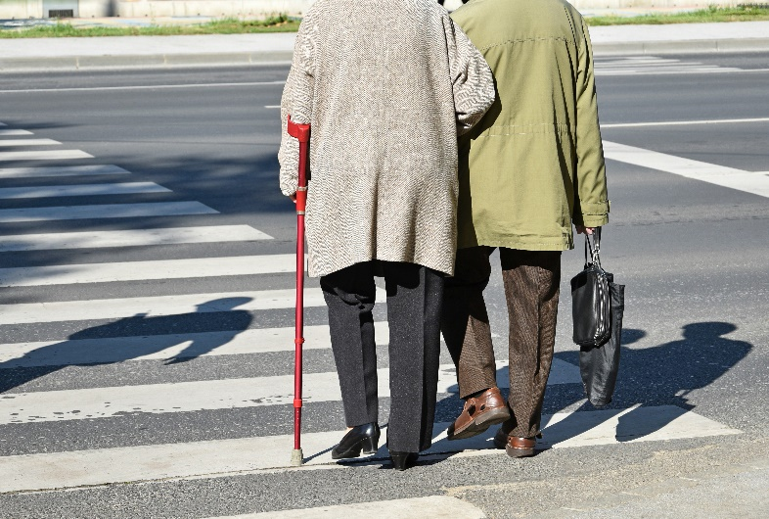
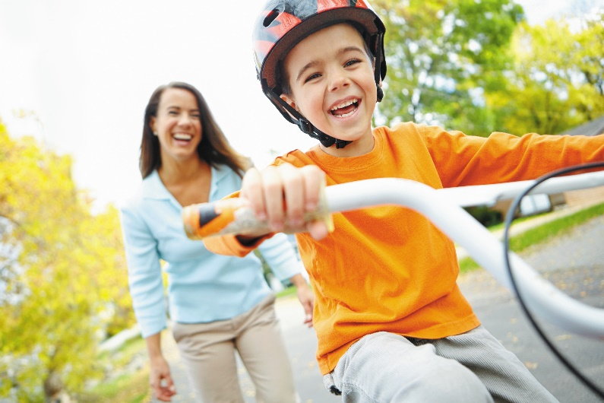
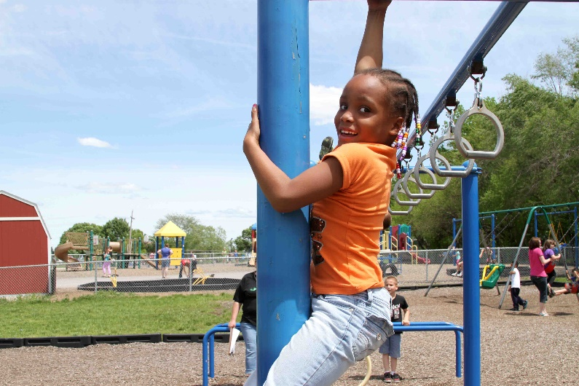
Enhancing physical activity
Healthy
Built Environment

Slide 9
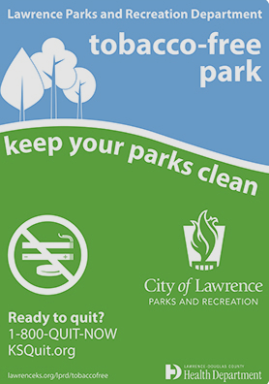
LiveWell – other areas of focus
Notes:
LiveWell has additionally worked with the Health Department, the Sexual Trauma and Abuse Care Center, and local community residents to form work groups to address tobacco use and sexual violence prevention. LiveWell will continue to utilize multi-sectoral partnerships to respond to emergent community opportunities and needs, and leverage funds for our community.

Slide 10
LiveWell – operational/ financial support

Slide 11
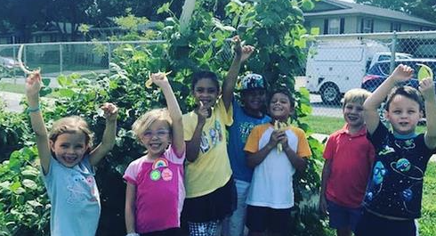
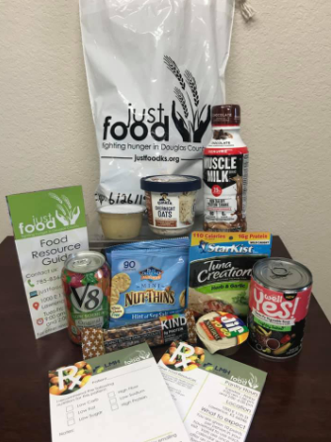
LiveWell – current initiatives

Slide 12
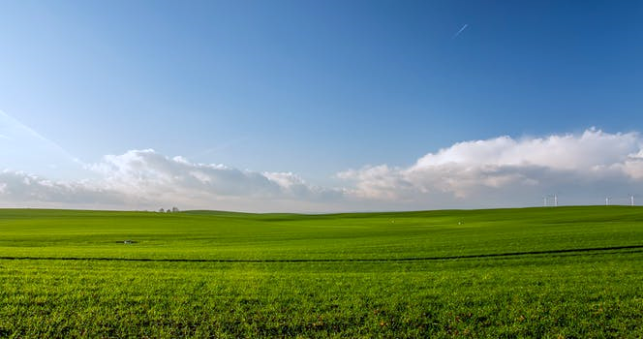
What’s Ahead
LiveWell strives to be a trusted partner and mobilizer in our community
We look forward to sustaining and growing efforts to improve conditions for health for all

